Slide 1
Express Entry
Human Capital Streams
Canadian government focuses on federal skilled workers as the demand is more there is an increase in accepting applications in Canada from different countries.

Slide 2
Also in 2018, Canada admitted more than 92,000 new permanent residents through the Express Entry system, an increase of 41% over 2017.
In 2018, the top 5 invited occupations were:
Software engineers,
Designers,
Information systems analysts,
Consultants,
Computer programmers,
Interactive media developers,
Financial auditors,
Accountants, and Administrative assistants.

Slide 3
Candidates from the following countries
India,
China,
The Philippines,
Nigeria,
Pakistan,
Syria, and
The USA
Were ranked at the top of the list of immigrants that got admitted into Canada as PR.

Slide 4
If your Job Title and skillsets fall in any of the below-mentioned categories, you will have a good chance of getting accepted as Canadian PR, provided you meet other requirements as per IRPA regulations.
Computer and information systems managers
Computer engineers (except software engineers and designers)
Database analysts and data administrators
Software engineers and designers
Computer programmers and interactive media developers
Web designers and developers.

Slide 5
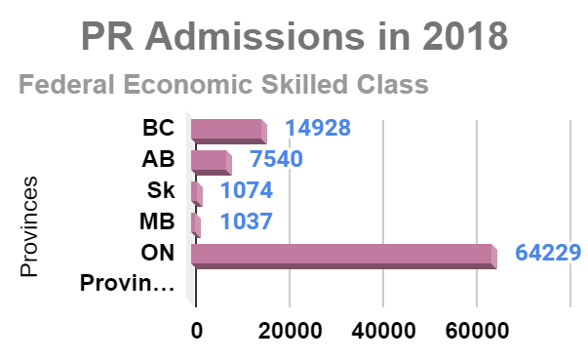
Canadian Govt focuses on bagging 233,368.00 admissions by the year 2023 which has seen a steep hike in no of PR admissions.

Slide 6
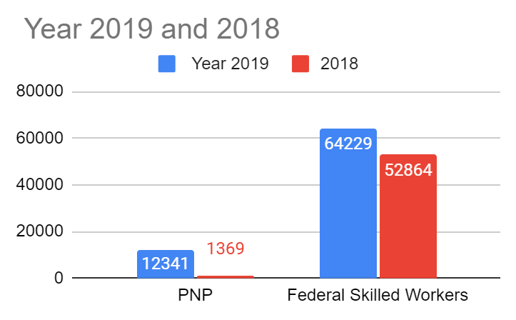
Ontario province has seen 64229 72.3% PR candidates in Federal Skilled Workers and PNP 12341 for the year 2019 whereas in the year 2018 it has seen 52864 Pr admission in FSW and 1369 in Provincial Nomination Program.
The other provinces that recorded the highest no of PR in the Federal Skilled worker Category are BC with 14928 16.8% and Alberta stands with 8.5% 7540.

Slide 7
Contact us :
info@penchantimmigratinvisa.ca
www.penchantimmigrationvisa.ca

